Slide 1

Regex for Complete Noobs
Thomas Rayner
Sr Security Service Engineer
Microsoft

Slide 2
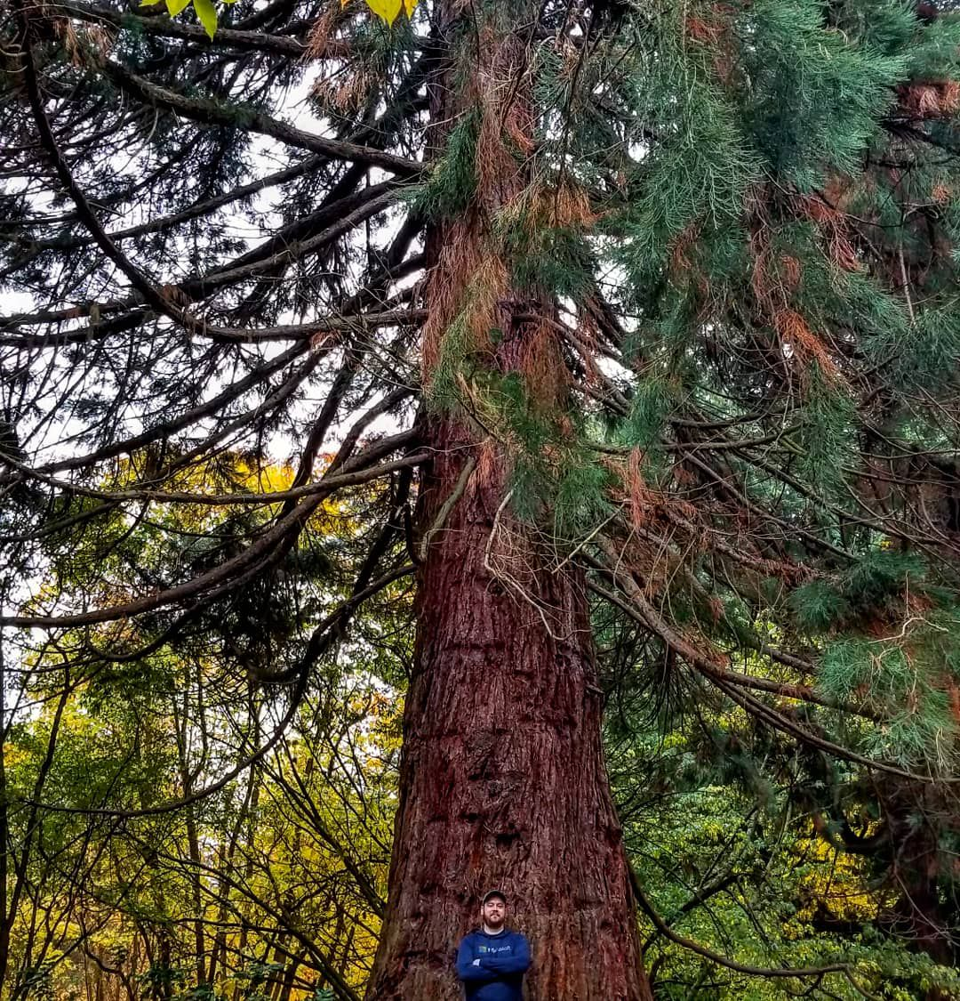

Find Me
@MrThomasRayner
thomasrayner.ca
PowerShell Discord/Slack
Join: aka.ms/psdiscord or aka.ms/psslack

Slide 3
What is regex?
Short for “regular expression”
Sequence of characters that defines a search pattern
Used to find or replace items in strings
Especially handy for
Extracting text from files like logs
Determining if a value exists in some user input
Replacing parts of a string with other values

Slide 4
You’re already doing it!
$arrayOfStuff = @( 'somethingone', 'somethingtwo', 'noway' )
$arrayofStuff | Where-Object { $_ -match 'something’ }
Returns
somethingone
somethingtwo

Slide 5
Boolean Matching
'somethingone' -match 'something’
Returns True
'somethingone' -match 'pickles’
Returns False

Slide 6
Simple Replacements
'Here is a simple string.' -replace 'simple string', 'string that got something replaced’
Returns
Here is a string that got something replaced.

Slide 7
Quantifiers
How many of whatever

Slide 8
Star Symbol – Zero or More
'something.txt' -match 's*omething.txt’
Returns True
'something.txt' -match 'q*omething.txt’
Returns True
'omething.txt' -match 'q*omething.txt’
Returns True

Slide 9
Plus Symbol – One or More
'something.txt' -match 's+omething.txt’
Returns True
'something.txt' -match 'q+omething.txt’
Returns False
'omething.txt' -match 's+omething.txt’
Returns False
'omething.txt' -match 'q+omething.txt’
Returns False

Slide 10
Question Mark – Zero or One
'something.txt' -match 's?omething.txt’
Returns True
'something.txt' -match 'q?omething.txt’
Returns True
'omething.txt' -match 's?omething.txt’
Returns True
'omething.txt' -match 'q?omething.txt’
Returns True

Slide 11
Special Symbols
^\where things st\Art getting \weir\d$

Slide 12
. (Period) – Any Character
'something' -match 'some.hing’
Returns True

Slide 13
\n – New Line
@"
This is some multi
line text
"@ -match '\n’
Returns True
'no new line' -match '\n’
Returns False

Slide 14
\d - Numbers
'123' -match '\d’
Returns True
'no numbers here' -match ‘\d’
Returns False

Slide 15
\D – Not a Number
'123' -match '\D’
Returns False
'no numbers here' -match '\D’
Returns True

Slide 16
\w and \W – (non) Word Characters
'hello123' -match '\w’
Returns True
'hello123' -match '\W’
Returns False
'---' -match '\w’
Returns False
'---' -match '\W’
Returns True

Slide 17
^ and $ - Start and End of Line
'some value' -match 'value$’
Returns True
'some value again' -match ‘^value’
Returns False

Slide 18
\s and \S – (non) Whitespace
'whitespace is here' -match '\s’
Returns True
'butnothere' -match '\s’
Returns False
' ' -match '\S’
Returns False

Slide 19
Fun With Slashes
'\\path\with\slashes' -match '\slashes’
Returns False
'\\path\with lashes' -match '\slashes’
Returns True
'\\path\with\slashes' -match '\\slashes’
Returns True

Slide 20
And so on
^ Start of line
$ End of line
\A Start of string
\z End of string
. Any single character
\s Any whitespace char
\S Any non-whitespace char
\d Any digit
\D Any non-digit
\w Any word char
letter, number, underscore
\W Any non-word char
\b Any word boundary

Slide 21
Brackets
Round, square, and curly

Slide 22
Curly Brackets – Exactly How Many
'something123' -match '\d{3}’
Returns True
'something123' -match '\d{10}’
Returns False
'something123' -match '\d{2,4}’
Returns True
'something123' -match '\d{2,}’
Returns True

Slide 23
Round Brackets - Grouping
'hello123hello123' -match '(hello123){2}’
Returns True

Slide 24
Square Brackets - Sets
'something' -match '[fgh]$’
Returns True
'something' -match '[f-q]$’
Returns True
'something' -match '[h-q]$’
Returns False

Slide 25
Carets Inside Square Brackets Are Special
'something' -match '[^qrs]$’
Returns True
'something' -match '[^gh]$’
Returns False

Slide 26
Putting it in Action
Time to get some

Slide 27
Isolate a Username
'domain\username' -replace '\w+\\',‘’
Returns
username

Slide 28
Better Than Booleans
[regex]::Matches('domain\username', '\w+$’)
Returns
Groups : {0}
Success : True
Name : 0
Captures : {0}
Index : 7
Length : 8
Value : username
[regex]::Matches('domain\username', '\w+$').Value
Returns
username

Slide 29
Is that an IP address?
'192.168.1.1' -match '(\d{1,3}\.){3}\d{1,3}’
Returns True
'1,200,859' -match '(\d{1,3}\.){3}\d{1,3}’
Returns False

Slide 30

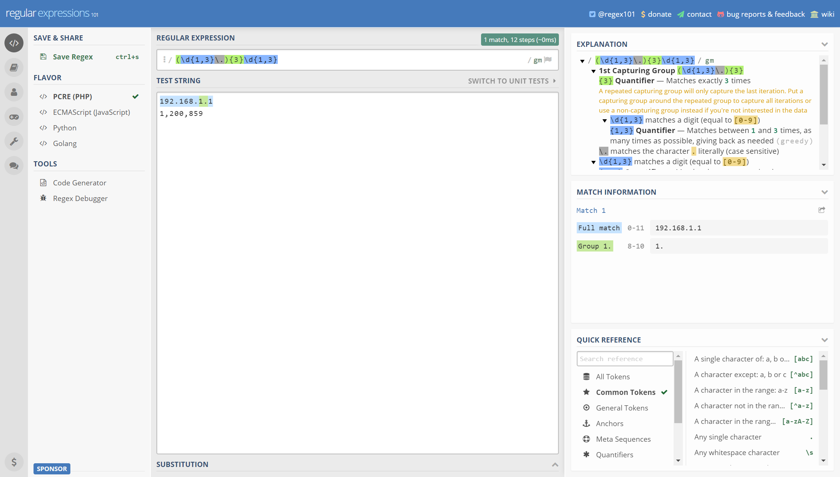
regex101.com

Slide 31
Question Time
@MrThomasRayner
thomasrayner.ca
PowerShell Discord/Slack
Join: aka.ms/psdiscord or aka.ms/psslack

